Slide 1

Research Productivity Tools (ADA23IN101)
FINAL REVIEW
Project Type / Domain: Internal / Machine Learning
Project Title: SignalWell AI — Digital Wellbeing Tracking and Research Demo
Presented By: 1. Ashwin A(E0324097)
2. Nikilesh J R(E0324098)
Guided By: Dr.Deena S

Slide 2
Contents
Introduction (Background Research)
Problem statement
Literature Survey (Min. 4 Research
Papers)
Objective
Workflow Diagram
Methodology
Tools and Techniques
Implementation (Dataset description/ environment setup)
Result Analysis (Graphs, Output Screenshots)
Timeline
Conclusion
Future scope
References (Min. 10 References)

Slide 3
Introduction
The Need for Balance: People spend a lot of time online, making it important to balance daily internet use with good sleep and mental health.
What is SignalWell AI?: It is a web app that tracks browser usage and lets users record their sleep, mood, and daily stress levels.
Two Distinct Modes: The app has a live version for real users and a separate testing mode that uses fake (synthetic) data for safe research.

Slide 4
Problem Statement
Main Problem Statement: Most screen time apps only tell the user how many minutes they spent on a device. They do not track how that screen time affects their mood or sleep.
Our Proposed Solution: SignalWell AI allows users to track both digital habits and physical well-being in one place. It also includes a safe, private sandbox mode to test smart data models without risking real user data.

Slide 5
Literature Survey
Research paper title and year | Author name and publication | Methodology | Advantages | Limitations
Digital phenotyping: Technology for a new science of behavior (2017) | T. R. Insel JAMA | Mapping human daily patterns using mobile frames. | Provides continuous behavioral tracking. | Relies on population averages instead of personal baselines
Opportunities and challenges in digital phenotyping data (2021) | J.-P. Onnela Neuropsychopharmacology | Analyzing continuous user digital activity data. | Gathers real-time daily routine habits automatically. | Struggles with deep user variation and data differences.
Digital Phenotyping for Stress, Anxiety, and Mild Depression (2024) | A. Choi et al. JMIR mHealth and uHealth | Tracking user interactions to monitor symptom shifts | Eliminates personal memory recall errors from surveys. | Lacks runtime model file validation registries.
Passive Sensing for Mental Health Monitoring Using ML (2025) | S. Shen et al. JMIR | Applying machine learning models to device sensor data. | Automatically monitors habits without disrupting routines. | High computational overhead; lacks database-level isolation.

Slide 6
Objective
Main Goal: Build SignalWell to help users track changes in their
digital habits and well-being.
Core Tasks:
  Habit Tracking: Log screen time and website usage safely via a browser tool.
  Personal Baseline: Compare metrics against a user's own 7-day average.
  Data Privacy: Lock down data using database Row Level Security (RLS).

Slide 7
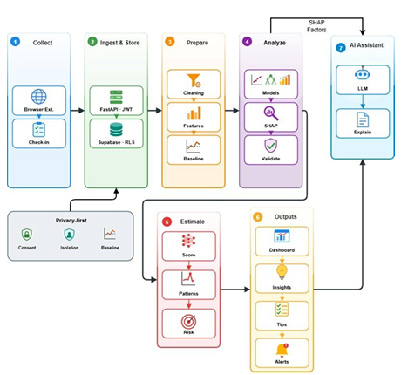
Workflow Diagram
Fig 1. Overall Workflow Diagram

Slide 8
Methodology
Data Integration: Tracks screen time, website use, sleep duration, mood, stress, and anxiety.
Personalized Baseline: Measures daily shifts against the user's past 7-day average using the equation:
\(\Delta X_t = X_t - \mu_{t-1:t-7}\).
Database Isolation: Applies Row Level Security directly to block cross-account data leaks (auth.uid() = user_id).
Runtime Verification: Implements server middleware to block inference requests if the model registry path is missing.

Slide 9
Tools and Techniques
Frontend Web App: Next.js 14, React 18, TypeScript, and Tailwind CSS.
Data Visualization: Recharts library for continuous behavioral trend graphs.
Database & Security: Supabase platform using a PostgreSQL engine with Row Level Security.
Browser Automation: Native JavaScript Service Workers built on Chrome Manifest V3.
Backend Processing: Python FastAPI framework run via a Uvicorn local server.
Machine Learning Tools: Pandas data processing, Scikit-learn models, and XGBoost structures.

Slide 10
Implementation
Core Monitored Attributes: Tracks Sleep Duration, Screen Time, Movement Level, Subjective Mood, Stress Response, and Anxiety Self-Assessment.
Dataset Characteristics: Evaluated using a simulated research dataset containing 2,500 daily tracking records distributed across 120 user accounts.
Environment Setup: Local deployment executing paths out of target user directory folders (C:\Users\ASUS\Documents\signalwell-ai-2) on local ports 3000 and 8000.
Validation Tools: Codebase rules checked using TypeScript compilers, Zod schemas, Pydantic data layers, and the pytest testing library.

Slide 11
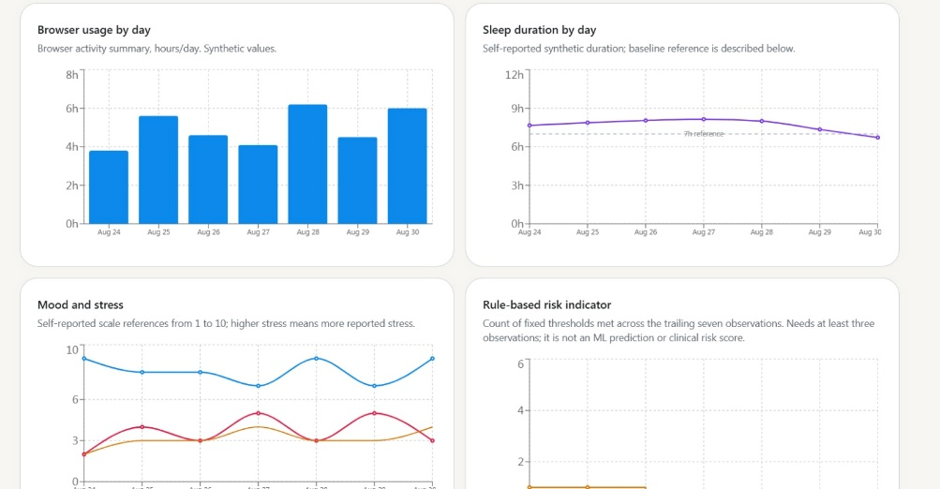
Result Analysis
Fig 2. Multi-signal visual trends grid

Slide 12
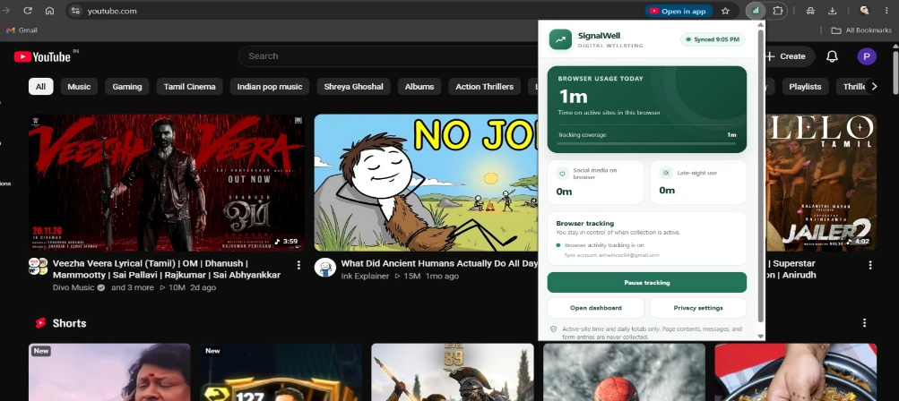
Fig 3. Opt-in Manifest V3 browser extension recording domain-level activity metrics with real-time cloud synchronization status.

Slide 13
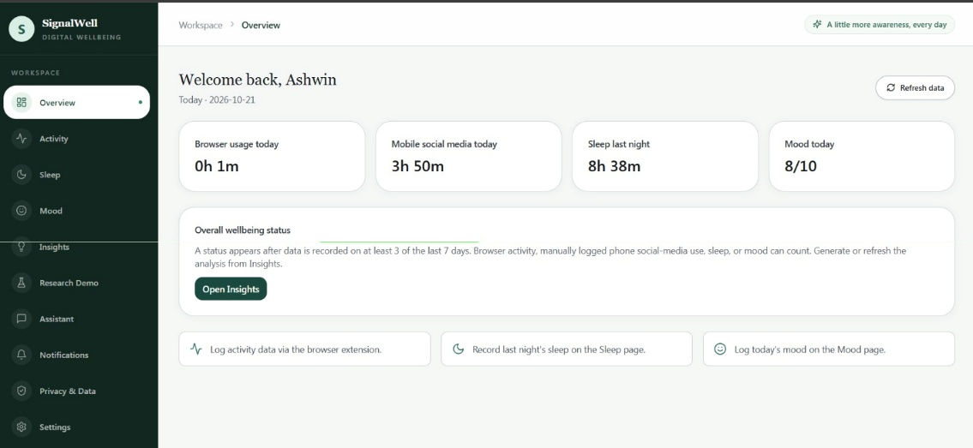
Fig 4. Next.js workspace overview isolating active tracking metrics and user logs

Slide 14
Timeline
06/05/25 - 13/05/25 (Duration – 8 days) : Initial project planning, research question setup, and database design.
14/05/25 - 20/05/25 (Duration – 7 days) : Created the opt-in Chrome Manifest V3 browser tracking tool.
21/05/25 – 27/05/25 (Duration – 7 days) : Configured Supabase login routes and Row Level Security privacy boundaries.
28/05/25 – 03/06/25 (Duration – 7 days) : Built the frontend user dashboard interfaces and added Recharts graphs.
04/06/25 – 10/06/25 (Duration – 7 days) : Coded the Python FastAPI background service and machine learning pipeline paths.
11/06/25 – 17/06/25 (Duration – 7 days) : Structured the 2 modes, 30-day versioned testing fixture data.
18/06/25 – 22/06/25 (Duration – 5 days) : Ran the automated pipeline test cases and completed final project reviews.

Slide 15
Conclusion
Safe Architecture: Decoupling the live database from a 30-day synthetic dataset enables secure ML testing without risking account contamination.
Verified Stability: The dual-path setup successfully verified 18 automated backend test cases under full model serialization loops.
Guaranteed Privacy: The system proves that health tracking over browser logs must be sandboxed by strict Row Level Security to stop cross-account leaks.

Slide 16
Future Scope
Cross-Browser Tracking: Build and expand tracking agents to cover multiple cross-browser platforms.
System Optimization: Implement a shared Redis architecture to handle production rate limiting effectively.
Compliance & Validation: Perform multi-jurisdictional compliance reviews and deeper learned model weight evaluations.

Slide 17
References
[1] T. R. Insel, “Digital phenotyping: Technology for a new science of behavior,” JAMA, vol. 318, no. 13, pp. 1215–1216, 2017.
[2] J.-P. Onnela, “Opportunities and challenges in the collection and analysis of digital phenotyping data,” Neuropsychopharmacology, vol. 46, pp. 45–54, 2021.
[3] A. Choi, A. Ooi, and D. Lottridge, “Digital Phenotyping for Stress, Anxiety, and Mild Depression: Systematic Literature Review,” JMIR mHealth and uHealth, vol. 12, e40689, 2024.
[4] S. Shen et al., “Passive Sensing for Mental Health Monitoring Using Machine Learning,” Journal of Medical Internet Research, vol. 13, 2025.
[5] T. Chen and C. Guestrin, “XGBoost: A scalable tree boosting system,” Proceedings of the 22nd ACM SIGKDD, 2016.
[6] SignalWell AI Project Specification Document & Poster, SRIHER(DU), 2026.

Slide 18
Thank you!

